Slide 1



HOTEL
AGGREGATOR ANALYSIS
MENTORNESS
USING POWER BI
Presented by Diksha Singh

Slide 2
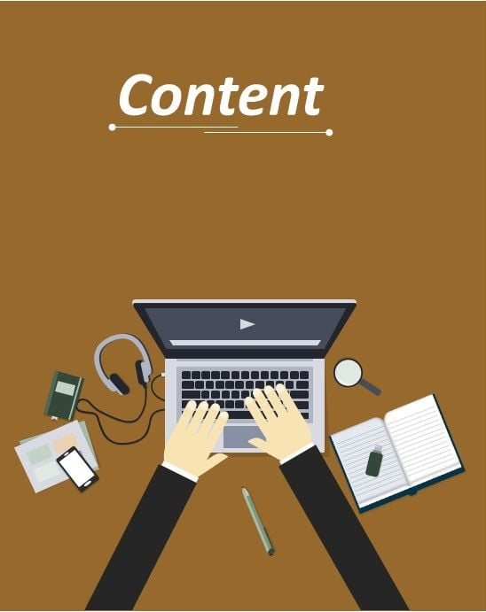
Content of the Project
MENTORNESS
1 About the project
2 Dataset Description
3 Import the Data
4 Cleaning the Data
5 Visualization of the Data
6 Dashboard
7 Analysis of the Data
8 Learning from the Analysis

Slide 3

Introduction to Analysis
MENTORNESS
The objective is to create comprehensive visualizations and insights that shed light on trends, patterns, and factors influencing the performance of listings. Through Power BI, We will explore key metrics such as pricing, availability, host characteristics, and review scores to derive actionable insights for improving the overall quality and competitiveness of the listings.

Slide 4
Data-set Description
MENTORNESS
id: Unique identifier for each listing.
listing_url: URL of the listing on the hotel aggregator platform.
scrape_id: Identifier for the data scraping event.
last_scraped: Date of the last data scrape.
source: Source of the listing information.
name: Name of the listing.
description: Description of the listing.
neighborhood_overview: Overview of the neighborhood where the listing is located.
picture_url: URL of the listing's picture.
host_id: Unique identifier for the host.
. (and many more columns capturing details about hosts, location, property type, room details, amenities, pricing, availability, reviews, and other relevant information)

Slide 5
Project Objective
MENTORNESS
1. Geographical Insights:
Visualize the distribution of listings on a map to identify popular neighborhoods.
Explore the geographical concentration of listings and host locations.
2. Pricing and Availability Analysis:
Analyze pricing trends based on property types, room types, and accommodation capacity.
Investigate the availability of listings over time and identify peak periods.
3. Host Performance:
Evaluate host characteristics, including superhost status, response times, and verification methods.
Explore correlations between host attributes and listing performance.
4. Review Scores and Guest Satisfaction:
Examine review scores and their impact on overall listing performance.
Identify areas for improvement based on specific review categories.
5. Property Type and Room Analysis:
Analyze the distribution of property types and room types.
Explore trends in the popularity of specific accommodation setups.

Slide 6
Skills Used
MENTORNESS
Data analysis and visualization
Power BI expertise.
Data storytelling
Insight generation and recommendation development

Slide 7
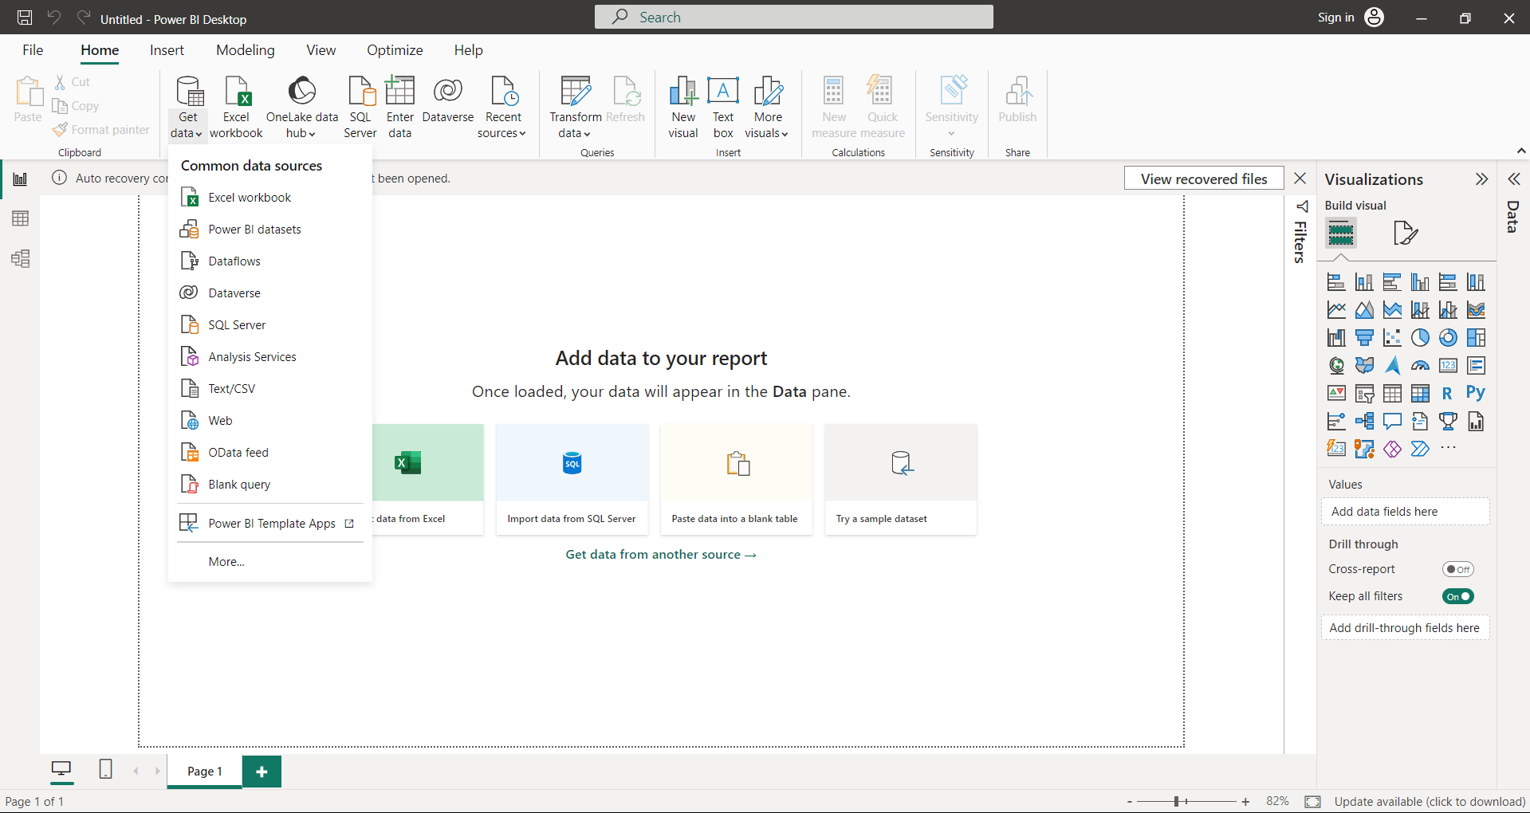
Import the Data
MENTORNESS
Open Power BI Desktop and click on "Get Data" in the Home tab.
Select "Text/CSV" as the data source.

Slide 8
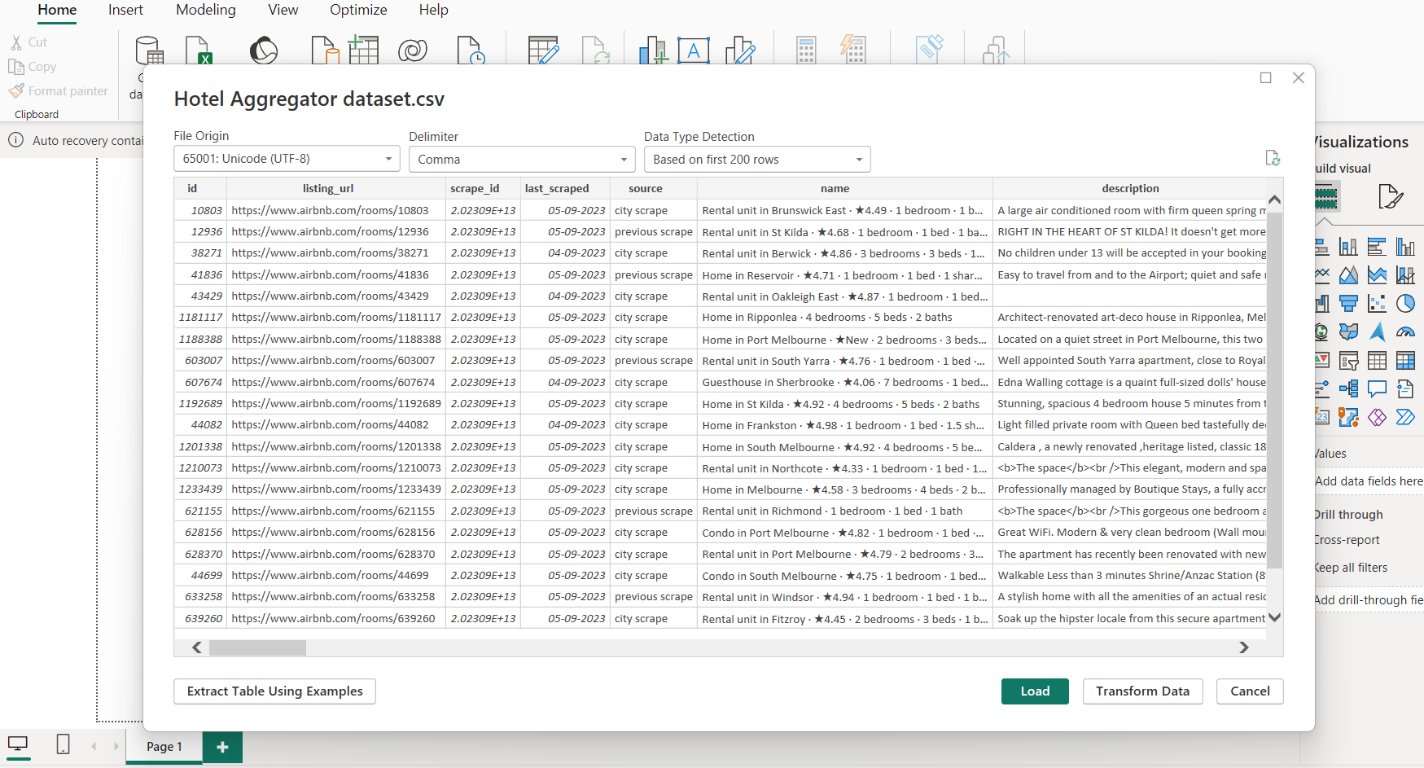
MENTORNESS
Click “Load” to import the data into Power BI
OR
Simply Click on Transform Data

Slide 9
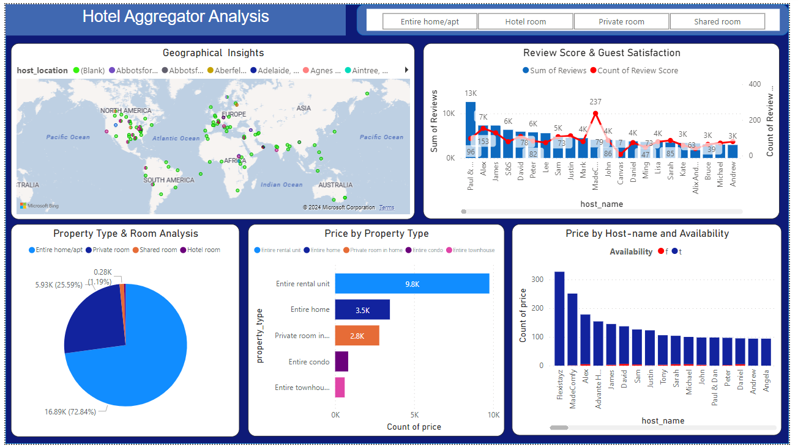
Geographical Insights
MENTORNESS
So, by looking at the map and these patterns, we can learn a lot about which neighborhoods are popular for renting out places and where hosts tend to be clustered.
It helps us understand where people want to stay and where hosts are happy to host them!

Slide 10
Pricing & Availability Analysis
MENTORNESS
Certainly! When we analyze pricing trends based on property types, room types, and accommodation capacity.
we're essentially looking at how much different kinds of places cost to rent, and how those prices change.
We can also look at how prices change over time. Maybe during certain times of the year, like holidays or special events, prices go up because there's more demand for places to stay.

Slide 11
Review Score & Guest Satisfaction
MENTORNESS
Guest satisfaction is typically measured through reviews and ratings that guests leave after their stay. These reviews might cover aspects like cleanliness, location, amenities, and the overall experience.
By analyzing these reviews and scores, we can understand how satisfied guests are with different listings and host performances.
We might find that certain hosts consistently receive high scores because they provide excellent service, maintain clean and comfortable accommodations, and are responsive to guests' needs.

Slide 12
Host Performance
MENTORNESS
Evaluating host characteristics such as superhost status, response times, and verification methods allows us to assess their impact on listing performance and identify opportunities to enhance the guest experience and drive booking success.

Slide 13
Property type & Room Analysis
MENTORNESS
Analyzing the distribution of property types and room types allows us to understand the diversity of accommodations offered and track trends in guest preferences over time.
These insights can inform strategic decisions related to property development, marketing strategies, and revenue management to meet the evolving needs of guests and maximize occupancy and revenue potential.

Slide 14
Dashboard Overview
MENTORNESS

Slide 15
CONCLUSION
MENTORNESS
This project aims to provide actionable insights into the short-term rental market across key dimensions. Through geographical analysis, we'll identify popular neighborhoods and concentration areas. Pricing trends and availability analysis will reveal peak periods and strategies. Evaluating host performance metrics will help optimize service quality, while reviewing scores will uncover areas for improvement, ensuring enhanced guest satisfaction and long-term success in this competitive market.

Slide 16


THANK YOU
MENTORNESS
For joining me on this journey of exploring Hotel Aggregate Analysis.
Our knowledge and skills will continue to evolve with practice and experimentation.
FOLLOW ME
https://www.linkedin.com/dikshaa-singh
https://github.com/dikshasingh09

